Slide 1




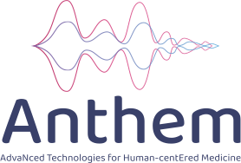
10th International Workshop on Artificial Intelligence and Cognition, Bologna, 25-26 october 2025
Network-Specific Models for Multimodal Brain Response Prediction
Andrea Corsico, Giorgia Rigamonti, Simone Zini, Luigi Celona, Paolo Napoletano
University of Milano-Bicocca, viale Sarca 336, 69121 Milano, Italy
Intelligent Sensing Lab
Financial support from:

Slide 2
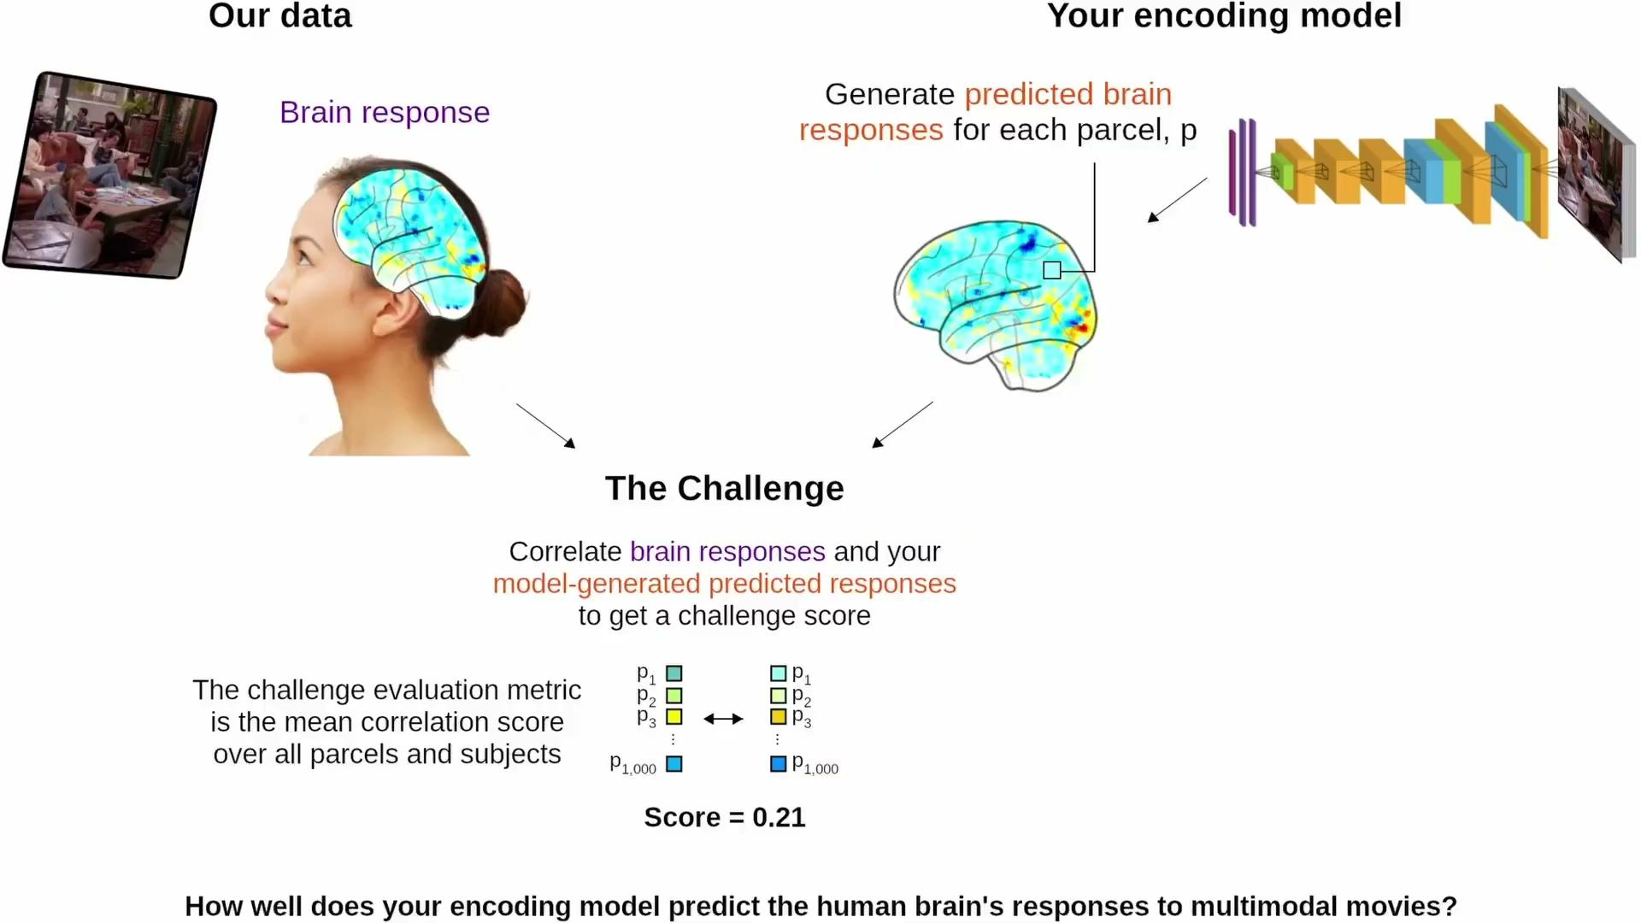
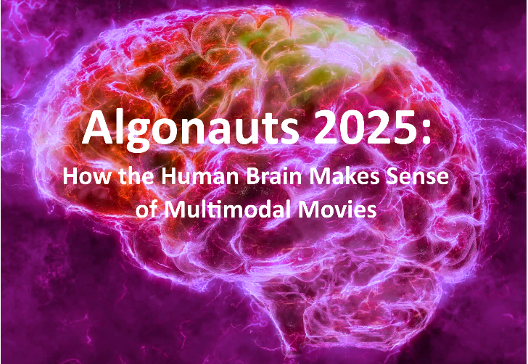
Motivation
Understanding how the brain integrates vision, sound, and language during naturalistic experiences remains a core challenge in cognitive neuroscience
We model brain activity evoked by movies using multimodal deep learning and functional brain network priors

Slide 3
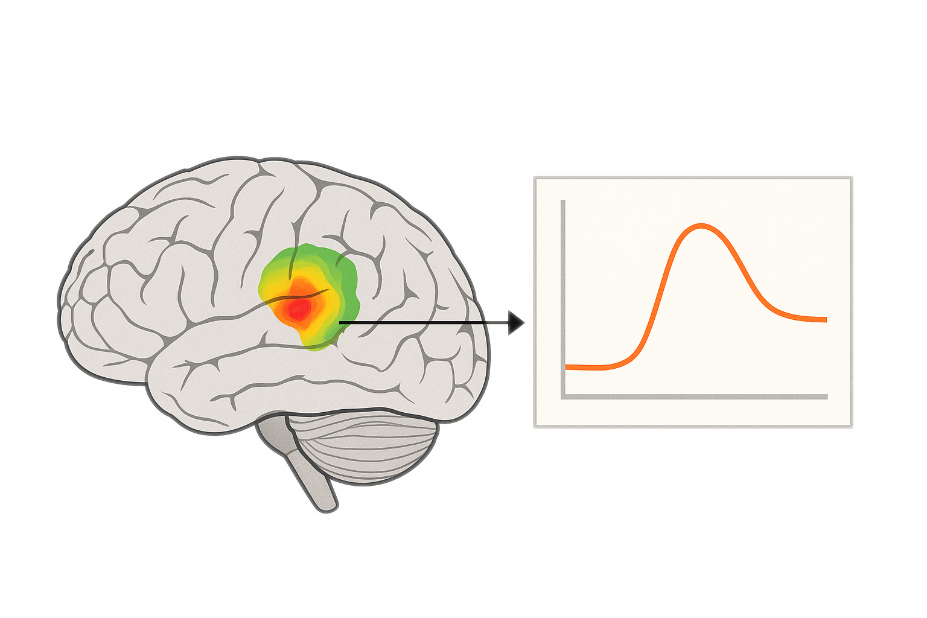
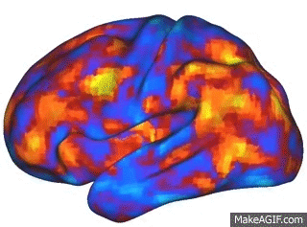
What is fMRI?
🩸
fMRI (functional Magnetic Resonance Imaging) measures blood-oxygen-level-dependent (BOLD) signals – an indirect marker of neural activity.
Each scan captures 3D brain volumes over time (~1.49 s per sample).
Signals are parcellated into 1,000 cortical regions using the Schaefer atlas.
The BOLD signal lags neural activity by ~4–6 seconds due to vascular dynamics.
⏱️
🧠
📈
fMRI captures slow hemodynamic responses,
whereas EEG records fast electrical signals from neurons
Notes:
“Functional MRI doesn’t measure neural firing directly — it measures blood oxygenation, which changes when a region is active.
The signal we predict is delayed by a few seconds, so modeling that timing properly is crucial for linking stimuli to brain activity.”

Slide 4
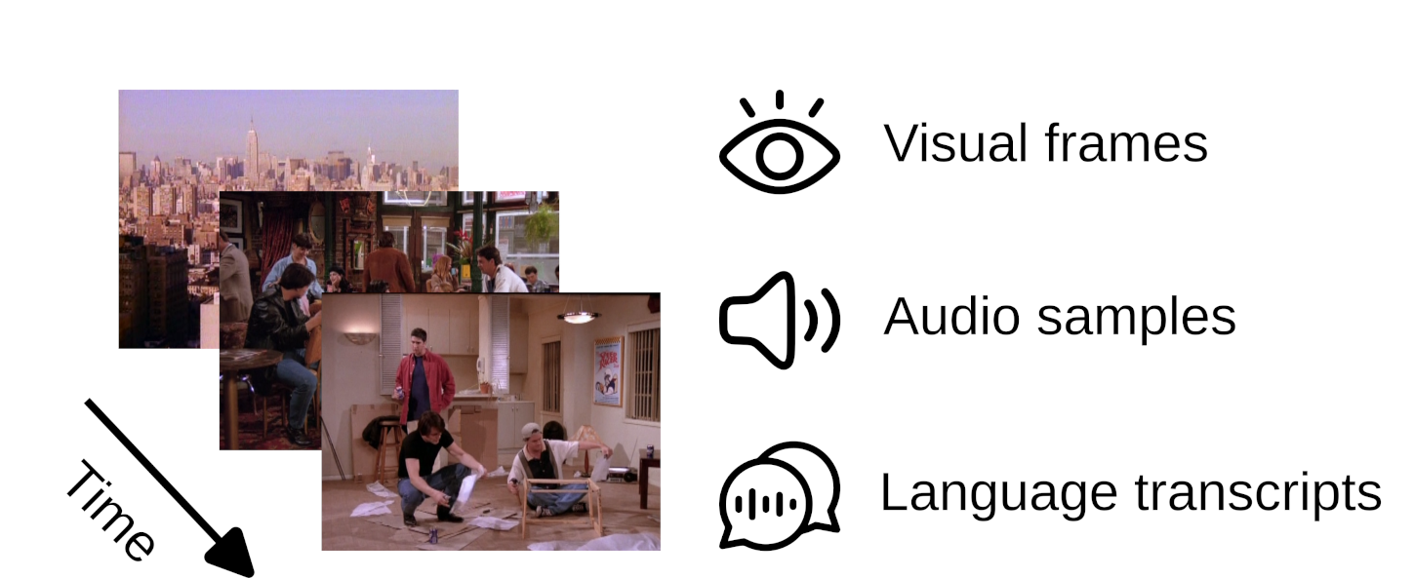
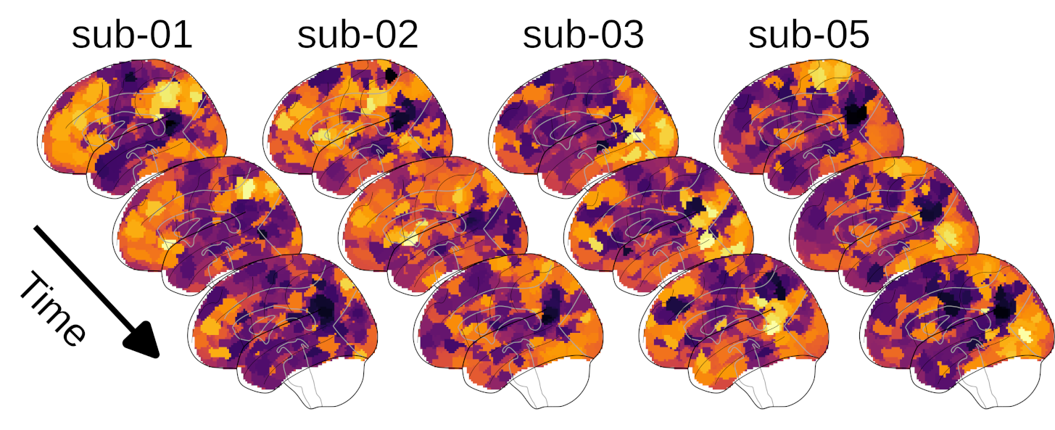
Dataset
Courtois NeuroMod Dataset
65 hours of movie stimuli and corresponding fMRI responses:
55 hours of seasons 1 to 6 of the sitcom Friends
10 hours for the following four movies: The Bourne Supremacy, Hidden Figures, Life (a BBC nature documentary), and The Wolf of Wall Street
~70h 4 1000
Duration Participants Brain Parcels
Multimodal Stimuli
fMRI Data
Frame rate: ~ 30 FPS
Resolution: 720×480 px
Audio: 44.1 kHz sampling rate
Timestamped language transcripts
Recording sessions: 12-15 min (~ half episode each)
Temporal resolution (TR) = 1.49 seconds
MNI template projection for standardization
Transformed to Schaefer-1000 functional atlas
Notes:
MNI template projection for standardization is a process of spatially normalizing individual brain scans to a common MNI (Montreal Neurological Institute) template

Slide 5
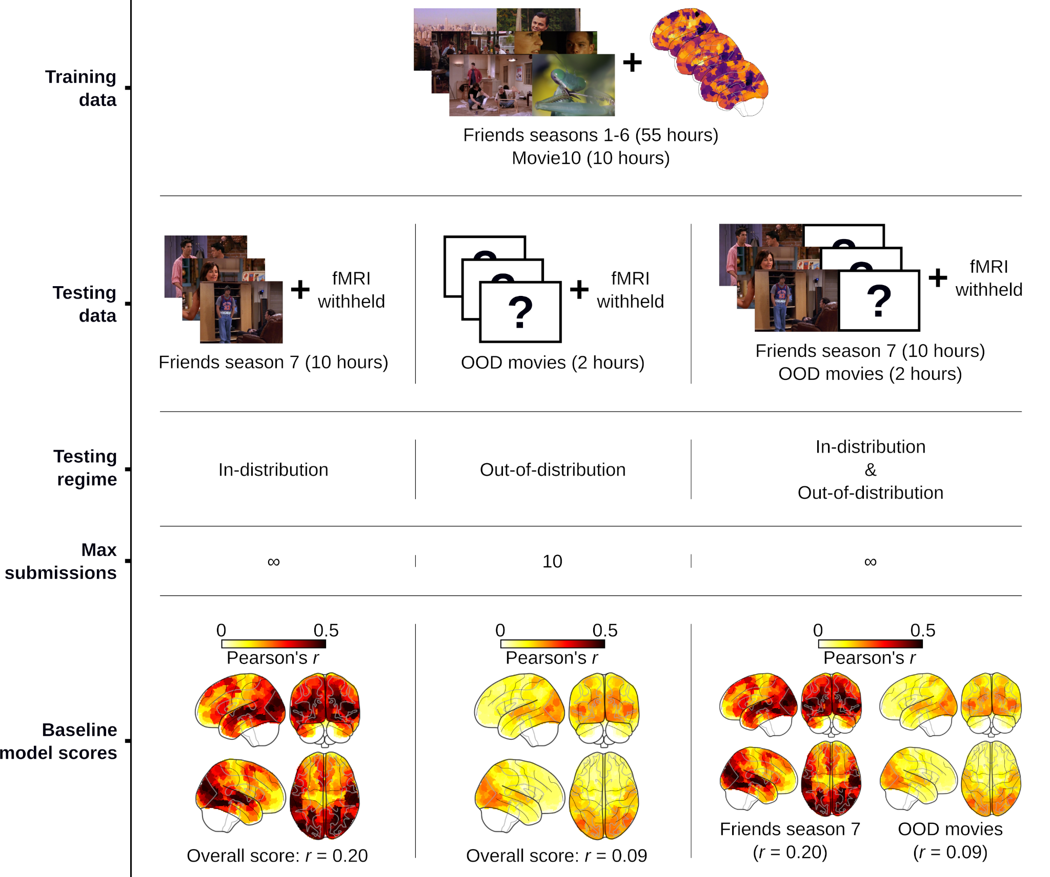
The Algonauts 2025 challenge
Task: predict brain responses to movie clips.
Evaluation: Pearson correlation per voxel.
Goal: Achieve high accuracy on a new Friends season (in-domain, ID) and strong generalization to unseen movies (out-of-domain, OOD).

Slide 6


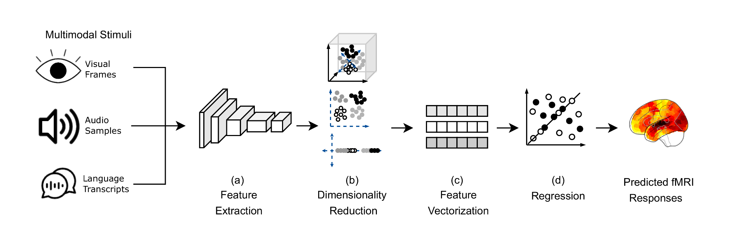
Proposed Model
[ 0.42, -0.87, 1.15, ..., 0.08, -1.02, 0.67]
1.49 s
BOLD measurements for the 1000 cortical regions
Notes:
“Our architecture takes visual, auditory, and language features from movie stimuli, reduces and aligns them in time, and predicts brain activity across 1,000 regions.
Each network group has its own specialized model, and we train across subjects using a shared MLP backbone.”

Slide 7
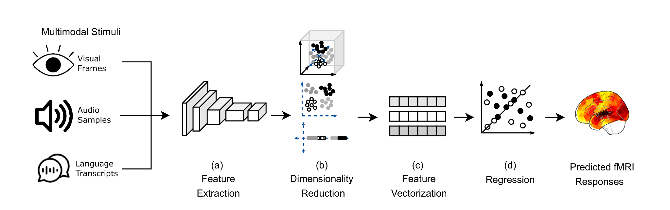
Proposed Model - Feature Extraction
ViNET captures attentional saliency, highlighting where humans focus visually in each frame.
VideoMAE2 encodes spatiotemporal dynamics, modeling object motion, scene changes, and visual context over time.
Together, they represent both low-level perception (salient regions) and high-level visual semantics (actions and scenes)
Wav2Vec2.0 captures speech content and phonetic structure, reflecting linguistic and prosodic information.
AudioPANNs extract environmental and musical cues, encoding non-speech sounds like ambient noise or music.
openSMILE models low-level acoustic and emotional prosody, capturing intonation, rhythm, and affective tone.
Combined, they encode the semantic, environmental, and emotional dimensions of the auditory stream.
RoBERTa represents semantic and contextual meaning from subtitles aligned with the fMRI timeline.
Intermediate layer embeddings (layer 8) capture conceptual and syntactic structure most correlated with brain activity.
Reflects high-level linguistic processing in cortical language networks
Notes:
VideoMAE2

Slide 8
Proposed Model - Dimensionality Reduction
Principal Component Analysis applied uniformly across modalities, compressing each to a 250-dimensional feature vector

Slide 9
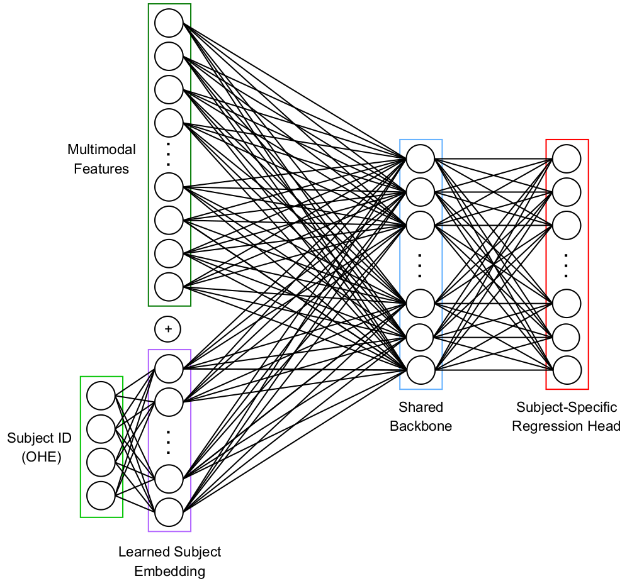
Proposed Model - Feature Vectorization & Regression
Multimodal features are concatenated with a learned subject embedding derived from one-hot encoded subject IDs.
A shared backbone network learns common representations across all participants.
Subject-specific regression heads model individual variability in brain responses.

Slide 10
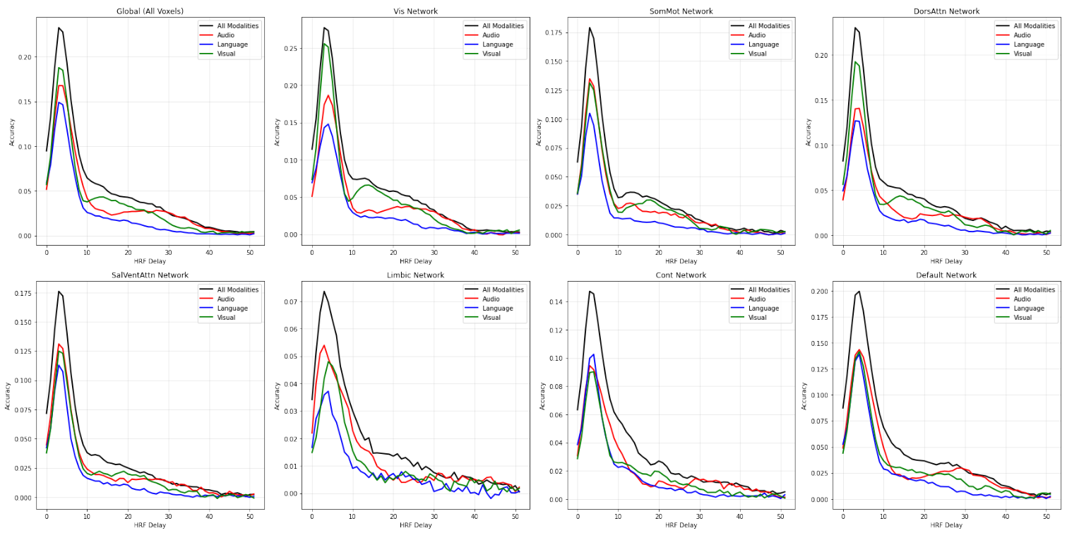
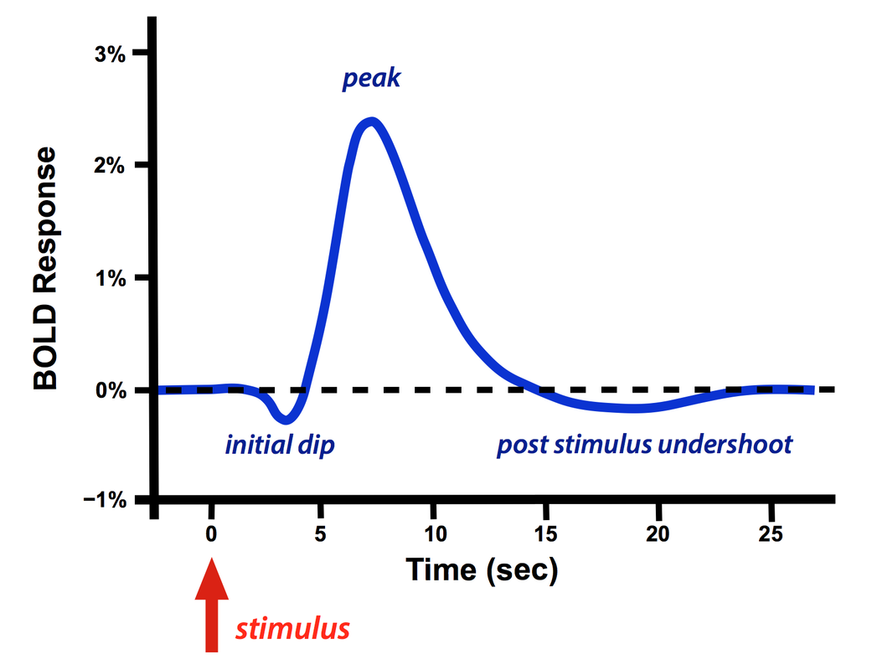
Proposed Model - Yeo Network–Specific Memory Dynamics
Hemodynamic Response Function
Models the delayed BOLD response to neural activity.
Peak ≈ 4–6 s, return to baseline ≈ 12–20 s. We found that 2 s works better.
Essential for accurate temporal encoding in fMRI models.
Unique temporal profiles for each modality–network pair, highlighting memory-related effects.
Visual and Dorsal Attention benefited from visual memory; Somatomotor from both visual and auditory.
Four MLPs—one per network with distinct modality behavior, plus a fourth for the remaining four networks.

Slide 11
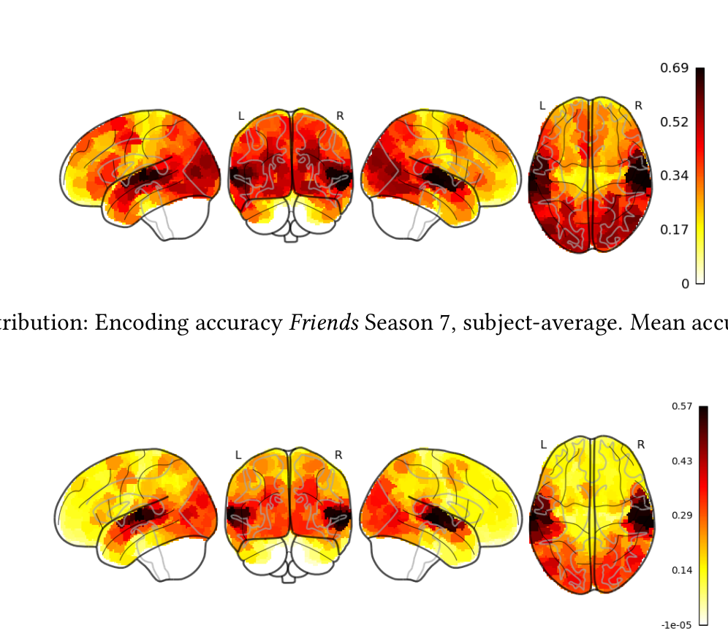
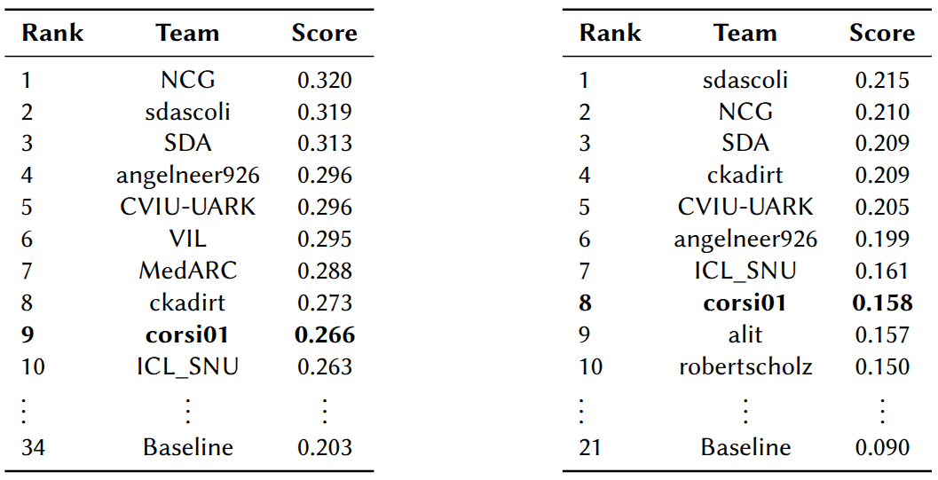
Results Overview
In-distribution
Robust predictions in auditory and language regions.
Stable patterns across subjects and stimulus domains.
Performance drop in visual regions → domain gap (animated vs. live-action).
Maintained functional consistency in temporal cortex.
Challenge Leaderboard
Out-of-distribution

Slide 12
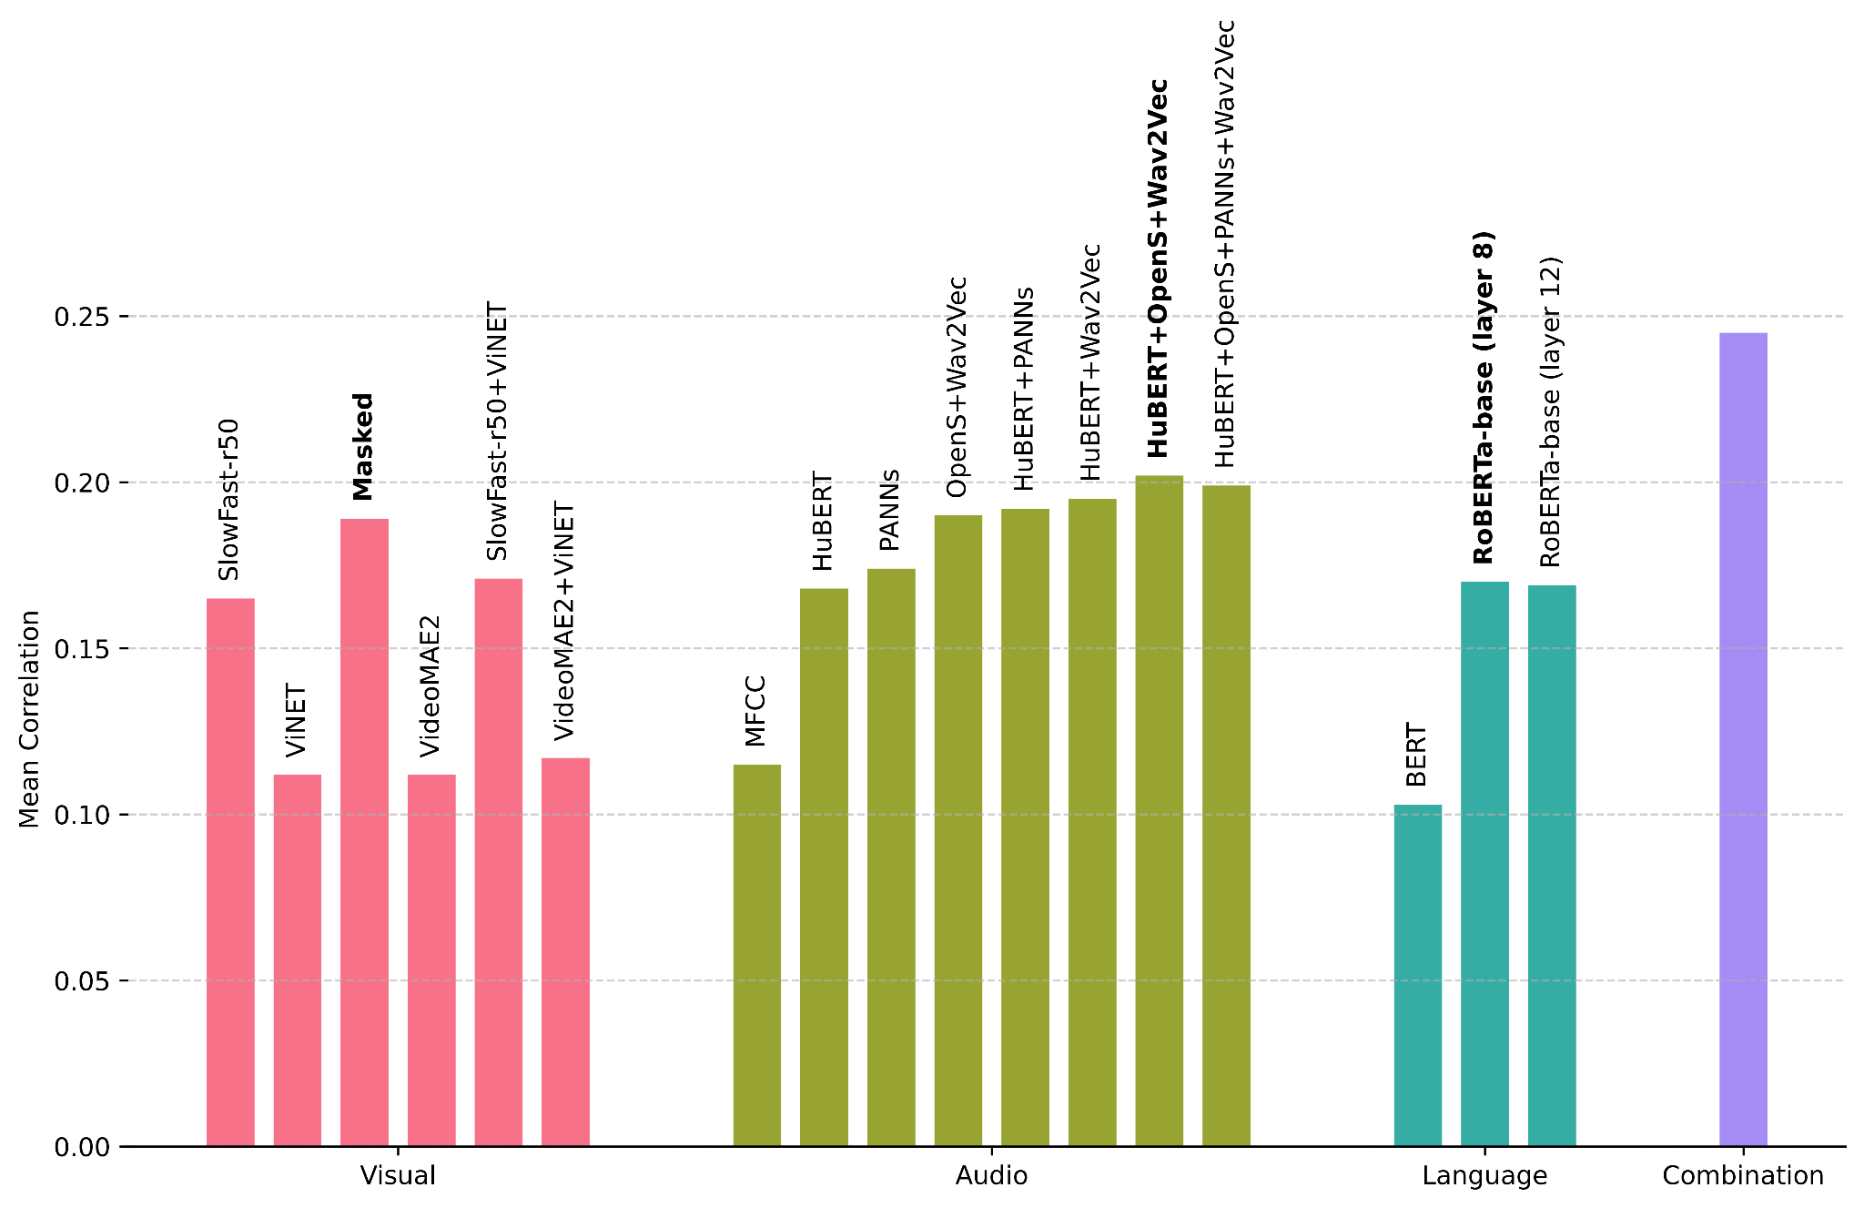
Ablation Study
Visual: ViNET saliency masking → best performance (↑ focus on relevant regions).
Audio: Wav2Vec2.0 + AudioPANNs + openSMILE → 0.202 (+0.087 vs MFCC).
Language: RoBERTa (L8 + attention) → 0.170 (+0.067 vs baseline).

Slide 13
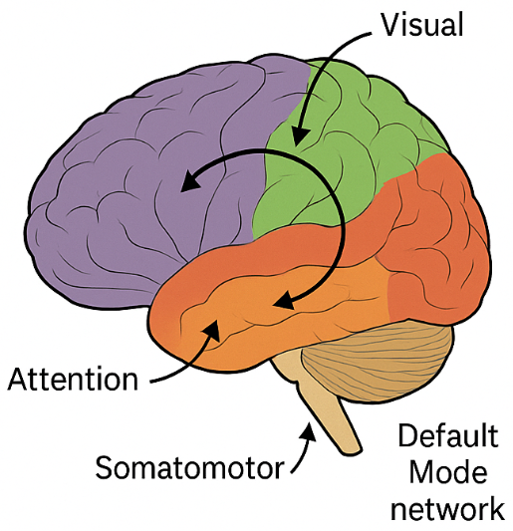

Cognitive Interpretation
Distinct networks show specialized multimodal integration.
Visual & Attention systems benefit from temporal memory → predictive processing.
Language regions align with semantic Transformer embeddings (RoBERTa L8).
Consistent spatial patterns across subjects → shared neural coding principles.

Slide 14

Conclusions and Future Work
Main Contributions
Network-specific multimodal model based on Yeo 7 networks.
Rich visual, audio, and language features aligned with fMRI timing.
Multi-subject MLP capturing shared and individual variability.
Incorporating network-dependent temporal memory enhances sensory response prediction.
Top-10 in Algonauts 2025, doubling baseline OOD accuracy.
Key Insights
Brain networks show specialized multimodal integration.
Supports predictive-processing and hierarchical cognition.
Future Work
Add recurrent / transformer-based memory.
Extend to EEG, MEG, and larger datasets.
Align with multimodal foundation models.
Scan for GitHub repository

Slide 15


THANKS FOR YOUR ATTENTION!
https://islab.disco.unimib.it/

